Slide 1

Further Progress in Reducing Underage Drinking in Vermont and Addressing Prescription Drug Misuse:
Findings from the Evaluation of Vermont’s Partnerships for Success II Grant
Bob Flewelling
Amy Livingston
Sean Hanley

Slide 2
Partnerships for Success - Background
Vermont’s Partnerships for Success (PFS) project was funded through a three-year federal grant from the Center for Substance Abuse Prevention (CSAP) within SAMHSA
The grant was awarded in 2012
PFS was implemented by VDH’s Division of Alcohol and Drug Abuse Programs (ADAP), and directed by Lori Tatsapaugh-Uerz

Slide 3
Vermont PFS Goals
Reduce underage and binge drinking among persons aged 12 to 20
Reduce prescription drug misuse and abuse among persons aged 12 to 25
Increase state, regional, and community capacity to prevent underage drinking and prescription drug misuse by implementing a targeted regional approach

Slide 4
PFS Allocation of Resources
A total of six regions, defined initially by VDH Health Districts, were selected to receive PFS funding based on relative need.
Criteria used to select regions for funding included:
  Prevalence rates among youth for alcohol use, binge drinking and prescription drug misuse / SES disparities in rates / high percentage of population aged 10-24
  History of low prevention resources such as multi-year prevention grants awarded within the region
  Readiness and capacity (i.e. status of community coalitions, vacancies in key VDH staff positions)
Notes:
This represented a shift in ADAP’s past funding approach for large federal discretionary grants which was to issue a competitive RFP and fund primarily small, community-based organizations or coalitions. Coalitions can be very effective, but often serve only a small community or area and sometimes have difficulty sustaining efforts over time. By shifting to a more regional approach ADAP’s goal was to increase the efficiency and scale of efforts using the existing health district office infrastructure and staff to support regional implementation.

Slide 5
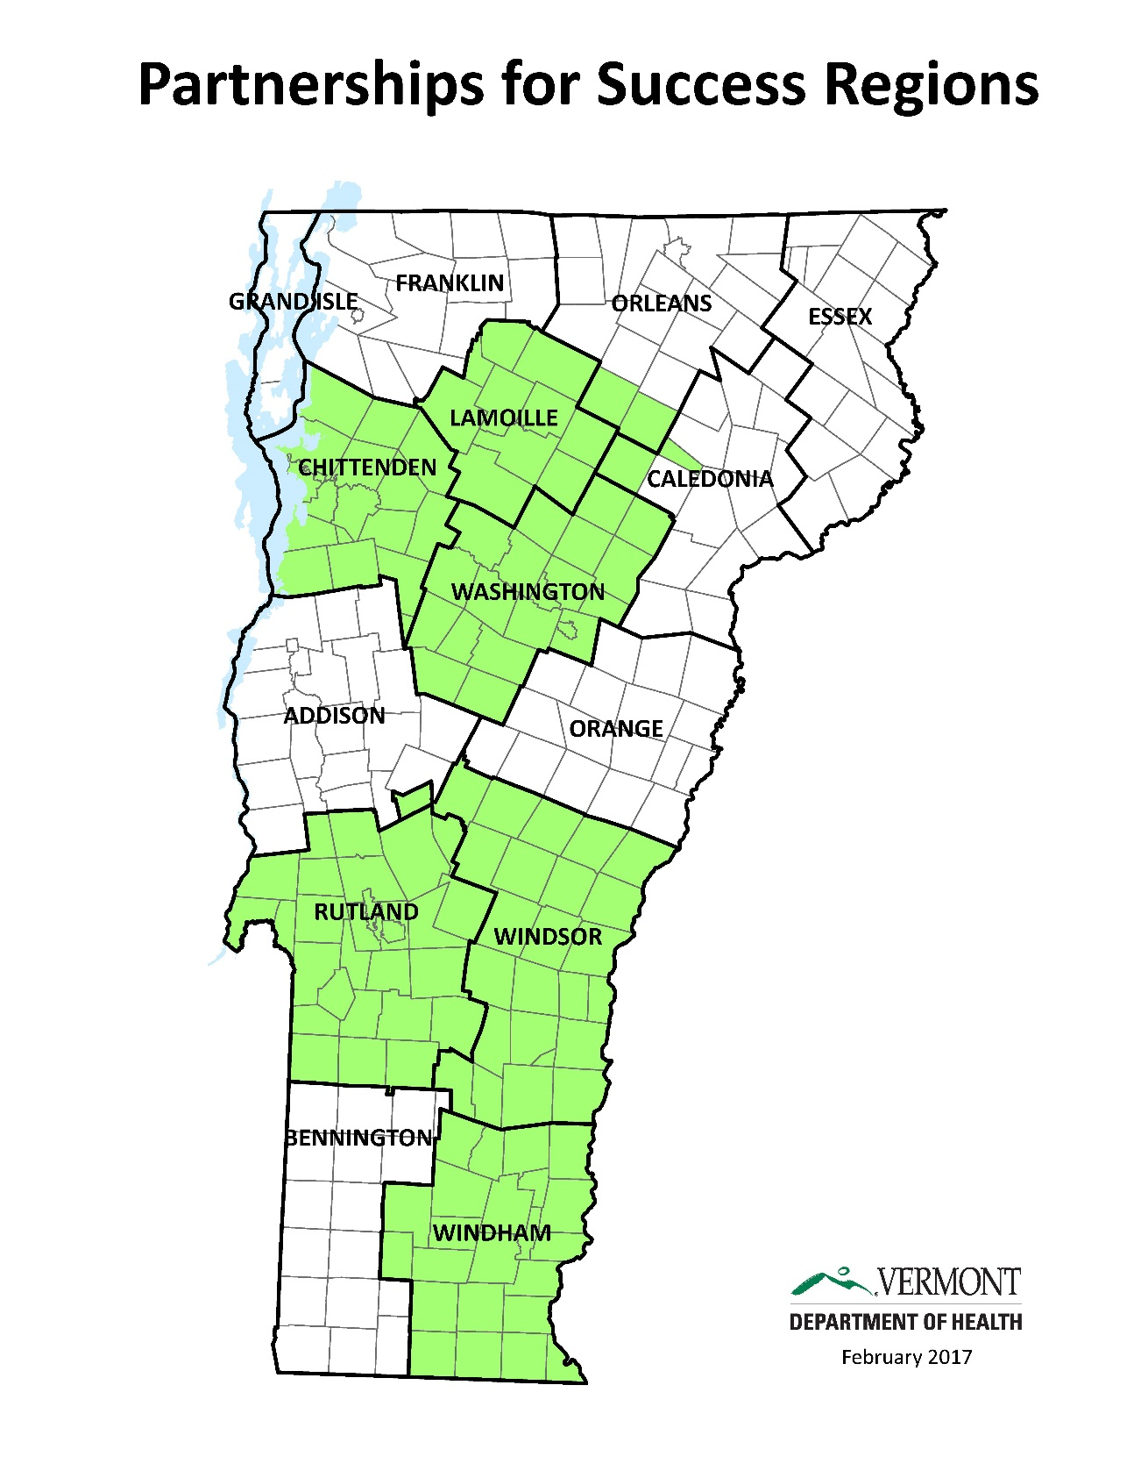

Slide 6
What is the Strategic Prevention Framework?

Slide 7
ADAP’s Role
ADAP provided regions with:
  A guidance document which outlined the steps in the Strategic Prevention Framework.
  Regional data profiles which included data on the prevalence, risk and protective factors and consequences of substance use.
  A menu of both required and optional evidence-based interventions and supporting activities to be implemented throughout the region.
  Ongoing training and technical assistance.
Notes:
Consequence data included ER discharge data, drinking and driving (YRBS), UAD citations

Slide 8
PFS Interventions
The interventions menu included interventions and activities at different levels of the Vermont Prevention Model to encourage a comprehensive mix of strategies.
Local policy approaches such as alcohol outlet density control and restrictions on alcohol in public places.
Enhanced enforcement of underage drinking laws
Media advocacy and community mobilization, communications campaigns, expansion of safe drug disposal sites
College-based online prevention education and screening such as Alcohol Edu
Parent education programs that emphasize family connection as a prevention tool
Prevention education for youth
Notes:
Most of the required strategies were at the Policies/Systems and Community levels of the Prevention Model because they are designed to impact a whole population such as youth or parents. These environmental strategies are more likely to lead to population-level changes because they work by changing the social context and community norms that promote healthy behaviors and decrease risky ones. Optional strategies included those that focused on small groups of parents or individual youth or young adults.

Slide 9
Assessment and Planning
A strategic planning process, led by District Directors and Prevention Consultants, was used to:
  examine data,
  assess community resources,
  define the specific geographic area to be served,
  engage community partners and
  select interventions and activities to be implemented.

Slide 10
Assessment and Planning Continued
ADAP approved strategic plans and provided detailed work plans for each intervention utilizing available fidelity guidelines.
In each region, a lead agency was selected to receive the funding and to coordinate the implementation of prevention activities.
Lead agencies hired a coordinator and also sub-granted money to community partners to assist with implementation.
PFS funding for communities began in July 2013 and continued through June 2016.
Notes:
Lead agencies included community coalitions, youth services agencies, a regional planning commission and a hospital

Slide 11
Evaluation Data Sources
Process evaluation:
  Community Grantee Reporting System (CGRS)
  Annual site visits
  Qualitative assessment of regional capacity done in summer 2015
Outcome Evaluation:
  YRBS 2013 (baseline) and 2015 (follow-up)
  Young Adult Survey 2014 (baseline) and 2016 (follow-up)

Slide 12
What did grantees do?
Grantees implemented an average of 11 evidence-based interventions and/or supporting activities across their regions.
Required strategies used by all grantees included:
  Education of policymakers and community members on policy options to prevent underage drinking,
  Community mobilization,
  Media advocacy,
  Support of enhanced enforcement of alcohol laws,
  Support of responsible beverage service training,
  Recognition of retailers for passing compliance checks, and
  Education to the community, pharmacists and health care providers about ways to reduce prescription drug misuse.
Additional optional strategies included online alcohol screening and education programs, parent education programs and Sticker Shock.

Slide 13
How well did they do it?
Progress on implementation and other process measures were collected and monitored through an online reporting tool called the Community Grantee Reporting System (CGRS) as well as through annual site visits.
Noteworthy accomplishments by grantees include:
  380,000 Vermonters were potentially exposed to PFS prevention initiatives through population-level interventions (approximately 60% of the state’s population)
  3 new community-level policies designed to reduce underage drinking were enacted.
  8 new permanent drop-off locations were established for the disposal of unused prescription medications.
  636 college students participated in an online alcohol screening and education program (Alcohol Edu).
  194 parents participated in parenting education programs.

Slide 14
Progress on Regional Prevention Structure (PFS Goal #3)
Measured through Focus Groups and Interviews with District Directors, PCs, Grantee Coordinators and Community Partners in Summer of 2015
Successes:
  Increased coordination, networking, and sharing of ideas and expertise across the communities within each region.
  Efficiencies from centralizing responsibility for communications campaigns and media outreach
  Greater penetration into communities and/or subpopulations that have traditionally been underserved.

Slide 15
Progress on Regional Prevention Structure (PFS Goal #3)
Challenges:
  Delineating and understanding the roles and responsibilities of different levels of the regional system including ADAP and District Office staff, lead agencies and community partners.
  Maintaining local connections that are viewed as critical to effective relationship building and successful prevention efforts while shifting to a regional lens.
  Resources are spread thin, especially in those regions with multiple community partners engaged in the work. Challenge is to maintain and sustain operations in a manner that maximizes benefits in relation to cost.

Slide 16
Outcome Evaluation:
Approach
Focus on population-level outcomes
    Sources: YRBS
    Young Adult Survey (YAS)
Examine changes over time in outcome measures in the funded regions
Compare changes in the funded regions to those in the remainder of the state

Slide 17
Timeline
2012
2013
2014
2015
2016
Intervention implementation
PFS begins
PFS ends
YRBS conducted
YAS conducted

Slide 18
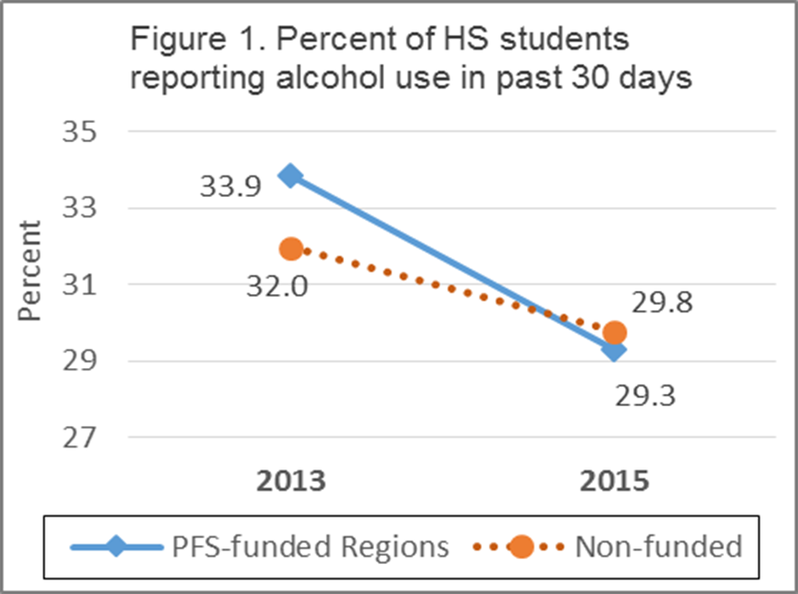
Outcome Evaluation Findings
Goal 1: Reduce underage and binge drinking among persons aged 12 to 20
PFS effect was significant at p<.05
Notes:
Significant (p<.05)

Slide 19
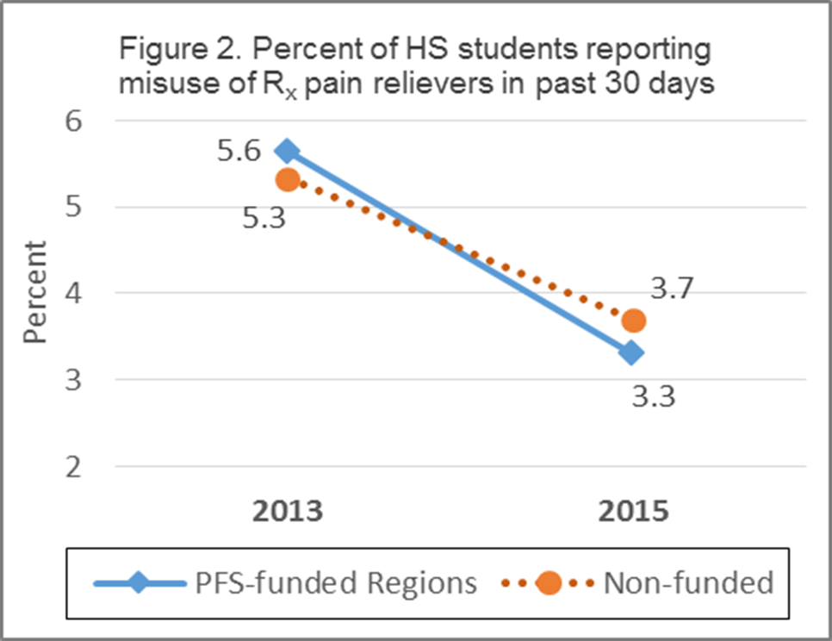
Outcome Evaluation Findings
Goal 2: Reduce prescription drug misuse and abuse among persons aged 12 to 25
PFS effect was significant at p<.10
Notes:
Significant (p<.05)

Slide 20
Summary of PFS effects on high school students (from YRBS)
 | Baseline Rate (PFS) | Pct Change¹ (PFS) | Pct Change² (Non-PFS) | Favorable Difference?^{3,4}
Substance Use Behaviors⁵
Current alcohol use | 33.9 | -13.4 | -6.8 | ✓**
Current binge drinking | 20.0 | -21.4 | -18.6 | ✓
Lifetime Rx pain reliever misuse | 11.4 | -26.8 | -24.8 | ✓
Lifetime Rx stimulant misuse | 7.8 | -15.3 | -11.5 | ✓
Current Rx pain reliever misuse | 5.6 | -41.5 | -30.5 | ✓*
Current Rx stimulant misuse | 4.0 | -29.2 | -27.9 | ✓
Risk Factors
Obtaining alcohol perceived to be sort of easy or very easy | 72.7 | -4.4 | -2.0 | ✓*
Drinking alcohol perceived to be a little bit wrong or not at all wrong | 50.5 | -9.8 | -6.6 | ✓
Perception that parents feel alcohol use by child is a little bit wrong or not at all wrong⁶ | 25.2 | 5.1 | 6.2 | ✓
Risk of harm from binge drinking perceived to be none or slight | 25.1 | -5.8 | -3.4 | ✓
¹Percent difference between 2013 and 2015 prevalence rates; cells showing decreases are shaded with green.
²Percent difference between 2013 and 2015 prevalence rates.
³Checked if a greater decrease (or less of an increase) was observed for PFS compared to non-funded areas.
⁴Statistical significance of difference in percent change was denoted as * if p<.10, ** if p<.05.
⁵Current use refers to use within the past 30 days. Binge drinking is defined as having 5 or more drinks on one occasion within the past 30 days.
⁶Or respondent was not sure about how parents felt.
Notes:
Significant (p<.05)

Slide 21
Summary of PFS effects on young adults (from YAS)
 | Baseline Rate (PFS) | Pct Change¹ (PFS) | Pct Change² (Non-PFS) | Favorable Diff?³
Substance Use Behaviors⁴
Current alcohol use | 77.6 | -4.0 | -2.6 | ✓
Current binge drinking | 59.7 | -16.1 | -9.2 | ✓
Current underage alcohol use | 66.6 | -7.8 | 2.0 | ✓
Past year Rx pain reliever misuse | 8.1 | -26.1 | -10.7 | ✓
Past year Rx sedative misuse | 5.7 | 23.3 | 73.1 | ✓
Past year Rx stimulant misuse | 12.4 | 11.2 | -15.7
Risk Factors
Obtaining alcohol from friends or family by persons 18-20 perceived to be very easy | 57.6 | -3.9 | -2.3 | ✓
Obtaining alcohol from stores by persons 18-20 perceived to be somewhat easy or very easy | 27.0 | 4.0 | 9.9 | ✓
Obtaining alcohol in restaurants & bars by persons 18-20 perceived to be somewhat easy or very easy | 16.5 | -9.6 | -11.1
Obtaining Rx pain relievers without a prescription perceived to be somewhat easy or very easy | 37.2 | -7.5 | -4.6 | ✓
Risk of harm from binge drinking perceived to be no risk or slight risk | 27.9 | -15.2 | -7.2 | ✓
Risk of harm from using R_{x} pain relievers not prescribed perceived to be no risk or slight risk⁵ | 23.4 | -1.9 | -0.5 | ✓
¹Percent difference between 2014 and 2016 prevalence rates; cells showing decreases are shaded with green
²Percent difference between 2014 and 2016 prevalence rates
³Checked if a greater decrease (or less of an increase) was observed for PFS compared to non-funded areas.
None of the differences were statistically significant.
⁴Current use refers to use within the past 30 days. Binge drinking is defined as having 5 or more drinks (if male) or 4 or more drinks (if female) on one occasion within the past 30 days.
⁵Or respondent reported that they did not know the risk.
Notes:
Significant (p<.05)

Slide 22
Summary of patterns observed across all outcome measures
Patterns for most outcome measures examined were similar to the two measures plotted earlier (although only a few effects were statistically significant). Specifically:
These patterns generally held for each of the six PFS-funded regions individually
 | Behavioral Measures |  |  | Risk Factors
 | Number | Number that decreased | Number of comps favorable to PFS | Number | Number that decreased | Number of comps favorable to PFS
Middle School | 4 | 3 | 4 | 4 | 3 | 2
High school | 6 | 6 | 6 | 4 | 3 | 4
Young Adult | 6 | 4 | 5 | 6 | 5 | 5
Total | 16 | 13 | 15 | 14 | 11 | 11

Slide 23
Statewide Evaluation Conclusions
  PFS represents a successful transition to a regional-based prevention system in Vermont, although challenges remain to enhance and sustain this approach
  PFS appears to have contributed to regional and statewide reductions in underage drinking and prescription drug misuse among youth and young adult Vermonters

Slide 24
a
Putting the PFS evaluation findings into the larger context…
To what extent have the PFS and other large federally-funded discretionary grants* for substance abuse prevention contributed to reductions in underage drinking in Vermont over the past 20 years?
* SIG, SPF-SIG, and PFS

Slide 25
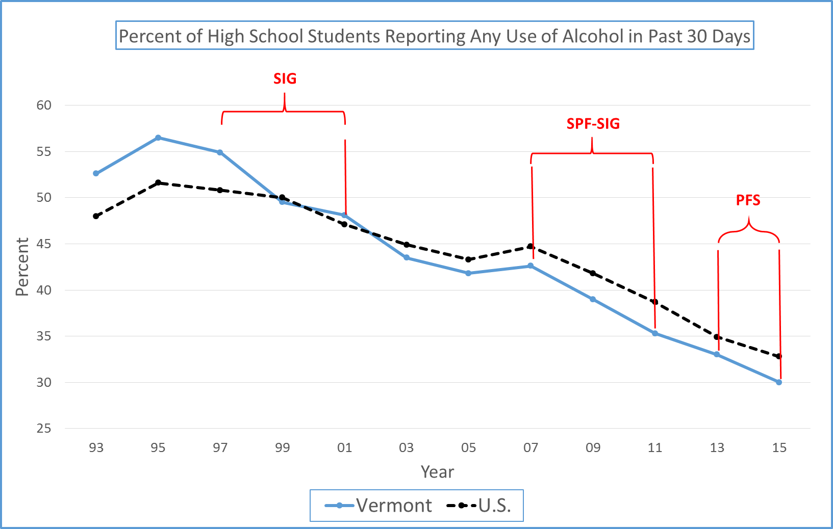

Slide 26
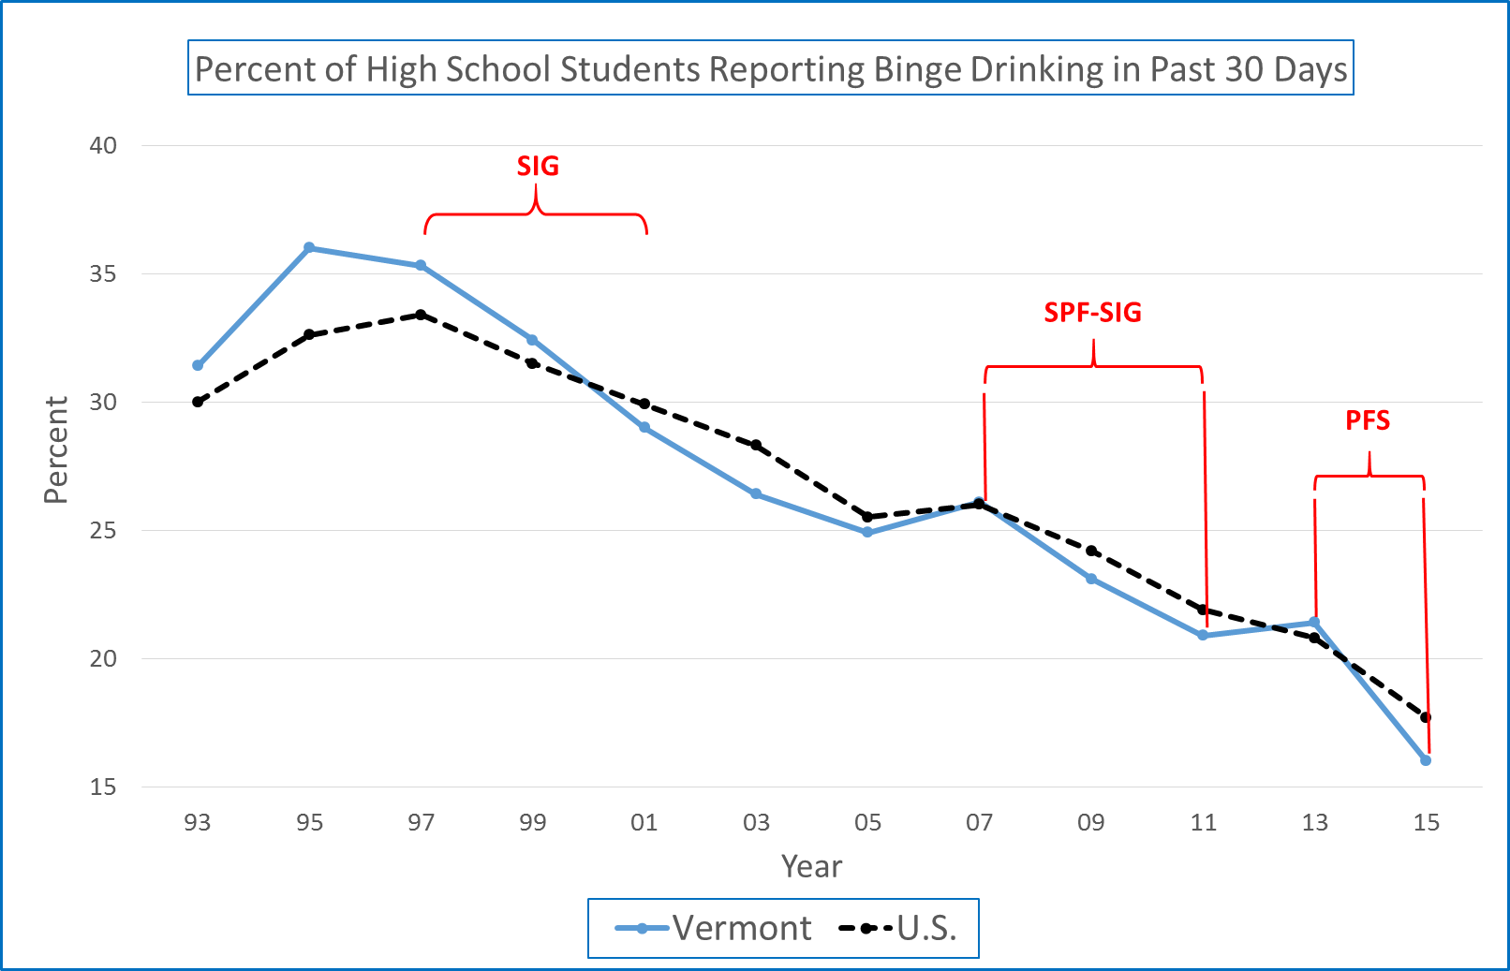

Slide 27
Current alcohol use trend summary: 1993 to 2015 (VT YRBS: high school)
 |  | Current alcohol use rates among high school students: Annual percentage point change from first year to last
Years | Federal Funding | Vermont | U.S. | Comparison to U.S. favors Vermont? | Difference (VT – U.S.)
93 to 97 |  | 0.57 | 0.70 | ✓ | -.13
97 to 01 | SIG | -1.70 | -0.92 | ✓ | -.78
01 to 07 |  | -0.92 | -0.40 | ✓ | -.52
07 to 11 | SPF-SIG | -1.83 | -1.50 | ✓ | -.33
11 to 13 |  | -1.15 | -1.90 |  | +.75
13 to 15 | PFS | -1.50 | -1.05 | ✓ | -.45

Slide 28
Binge Drinking trend summary: 1993 to 2015 (YRBS: high school)
 |  | Binge drinking rates among high school students: Annual percentage point change from first year to last
Years | Federal Funding | Vermont | U.S. | Comparison to U.S. favors Vermont? | Difference (VT – U.S.)
93 to 97 |  | 0.97 | 0.85 |  | +.13
97 to 01 | SIG | -1.57 | -0.88 | ✓ | -.69
01 to 07 |  | -0.48 | -0.65 |  | +.17
07 to 11 | SPF-SIG | -1.30 | -1.03 | ✓ | -.27
11 to 13 |  | 0.25 | -0.55 |  | +.80
13 to 15 | PFS | -2.70 | -1.55 | ✓ | -1.15

Slide 29
PFS Evaluation:
Links to reports and tools
ADAP brief (two-page) summary:
  ADAP web site (click on Plans and Reports and then PFS Evaluation Summary)
PIRE PFS II Evaluation Report:
  http://www.pire.org/documents/Vermont_PFS_Eval/Final Report.pdf
PIRE PFS Regional Structure Qualitative Study Report:
  http://healthvermont.gov/alcohol-drugs/reports/data-and-reports
YAS survey (list of all items):
  http://www.pire.org/documents/Vermont_PFS_Eval/YAS questions 2016.pdf

Slide 30

What next?
Regional Prevention Partnerships (RPP) continues funding to PFS-funded regions and is also funding 6 new lead agencies, under Vermont’s PFS 2015 grant, directed by Tin Barton-Caplin.

Slide 31
Contact Information
Amy Livingston
alivingston@pire.org
802-652-4111
Bob Flewelling
Flewelling@pire.org
919-265-2621

